Slide 1
Characterizing Database User’s
Access Patterns
Qingsong Yao, Aijun An and Xiangji Huang
{qingsong,aan}@cs.yorku.ca, jhuang@yorku.ca
York University
Toronto, Canada
Notes:
Good afternoon, everyone:
Today, my presentation topic is : SQL-Relay: An Event-Driven Rule-Base Database Gateway.

Slide 2
Topics
Motivation
User Access Patterns
  Frequently performed queries, time/resource-consuming queries.
  User Access Event and User Access Graph
Mining and Modeling User Access Patterns
  Log data collection and preprocessing
  SQL Query classification
  Database user identification
  Database session identification
  Database session clustering
  Database session modeling
Using User Access Patterns
Related Works
Conclusion

Slide 3
Motivation
The analysis of database workload plays an important role in optimizing the performance of database systems.
Previous workload analysis methods are from the view of the server, such as statistical summaries; buffer hit ratio.
It has been brought into attention that analysis of task-oriented user sessions provides useful insight into query behaviour of database users.
  A database user session is a sequence of queries issued by a user (or an application) to achieve a certain task. It consists of one or more database transactions, which are in turn a sequence of operations performed as a logical unit.
  The SQL queries submitted by a client or a user have specific meaning and have certain format.
  The queries within a user session follow certain business logics or rules and have certain order.
Our research tries to solve the question of
  How to model database user behavior?
  How to find database user behavior efficiently?
  How to use database user behavior?

Slide 4
User Access Patterns
We use user access patterns to describe the behaviours of a client application or a group of users.
The user access patterns of a client application or a user group contains:
  A collection of frequently performed queries.
  A collection of time/resource-consuming queries.
  A collection of frequent user access event associated with the parameter distributions that represent the query format
  A collection of frequent user access graphs that represent the query execution order.

Slide 5
User Access Event and User Access Graph
A user access event represents a set of similar queries. It contains a SQL template and a set of parameters
  SQL template: each value of a query is replaced by char ‘%’.
  Parameters: the corresponding values in the query, and can be constants or variables.
  For example, event (“select * from customer where id=‘%’, cid) represent a set of queries retrieving a given customer’s info.
A user access graph is a directed dependency graph, that represents the query execution order within a user session or the session execution order of a user
  The graph has one start node and one or more end nodes
  A node has a support value that is the frequency within session.
  An edge is represented by (i, j, k), where k is the probability of j following i, which is called the confidence value.
  A basic user access graph, whose nodes are events represent the query execution order. A high-level user access graph, whose nodes are graphs describes the orders among sessions of the same user.

Slide 6
An Example of User Access Graphs
The high-level user access graphs for a patient-information model: when a user log in (P1) , the profile is retrieved (P2). User either retrieves treatment history information (P3) or treatment schedule (P4). Finally, user logout (P5)
User access graph P: ( g_cid,g_date )
User access graph P3: (g_cid, g_date, g_tid)
0
.
8
1
.
0
v30(g_cid) v31(g_cid) v32(g_cid) v33(g_tid) v34(g_tid)
0
.
9
P3
0.7
1.0
0.6
1.0
0
.
2
1
.
0
P1
P2
P5
0.4
P4
An instance of treatment history retrieving session (P3)
q30: select count(tid) from treatment where cid = ’c101’
q31: select tid from treatment where cid = ’c101’
q32: select tid from treatment where cid = ’c101’
and status =‘1’
q33: select * from treatment_details where tid = ’t202’
q34: select card name from treatment_payment
where tid =’t202’
Same value
and same
query predicate
Same value,
Q33 can not be anticipated since the value ‘t202’ is unknown before it is requested, but Q34 does. Thus, Q33 contains a action that assigning variable g_tid as ‘t202’

Slide 7
Mining User Access Patterns
Database workload characterizing is based on database traces.
Traces are a collection of measures, such as pages read/written, locks, SQL statements, produced by all transactions being processed by the DBMS within a time interval.
The mining algorithm contains following steps:
  Trace data collection and preprocessing
  SQL query classification
  Database user identification
  Database session identification
  Database session clustering
  Database session modeling

Slide 8
Mining User Access Patterns (1)
Trace data collection and preprocessing
  Trace data can be collected either at the client/mediator, or at the server. Client-side tools can monitor client requests and server responses. Server-side tools can monitor different kinds of event occurred in the server.
  Noise data and irrelevant data are removed, and log entries are transformed to meaningful format.
  Frequent queries and time/resource-consuming queries are obtained.
Query classification
  Each SQL query is transformed into an SQL template and a set of parameters.
  A user access event is assigned for each SQL template.
  The parameter value distributions of a user access event are obtained.
  A sequence of events obtained by replacing the query with the corresponding event.

Slide 9
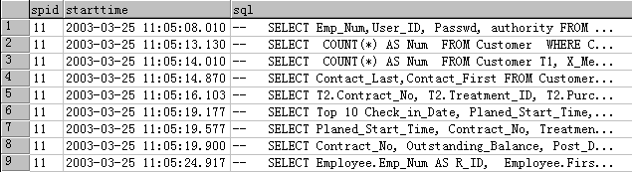
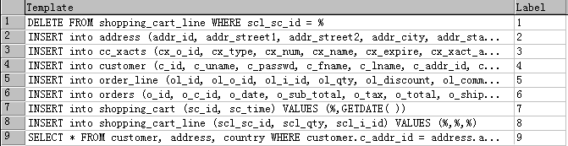
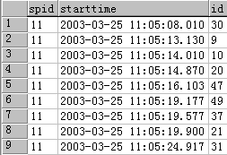
An Example
Database trace log
queries with the same connection id
User access events table
Event sequence table
Assigning each user access event a label
Obtain a sequence of event label

Slide 10
Mining User Access Patterns (2) - Database User Identification
The concept of "user" is not the database user that directly connects to the database server, but the user of database-based application
In a client/server application, requests submitted by the same application from the same address and use the same database connection are belonging to the same user.
It is non-trivial task to identify users from the traces when database users don’t connect to the database server directly, and may share database connections.
Queries within a user session usually has the same database connection, thus identifying sessions can help to find users.
Other kinds of log, such as web access log can help to find database users.

Slide 11
Mining User Access Patterns (3)
- User Session Identification
The task of session identification is to separate database sessions from a sequence of requests/events.
The most commonly used session identification method is called timeout.
  Assuming that the think-time between user sessions is longer than that between the events of a session.
  This session identification method suffers from the problem that it is difficult to set the time threshold.
Statistical language modeling (n-gram model) based session identification method is proposed.
  Using an information theoretic approach to identify session boundaries dynamically by measuring the change of information in the sequence of requests.
  Has been demonstrated to be more effective than timeout and two other methods in discovering association rules in a Web mining.
  The successful use of this method depends on how to select values for some parameters.

Slide 12
N-gram models
Given a sequence of words, what is the next possible word?
Markov assumption: the probability of a words depends only on the probability of a limited history.
n-gram Model: the probability of a word depends on the previous n-1 words, n is called the order of the model
Given a string W with N words, the possibility that it is spoken is
Data sparsity problem: training data is not big enough to get that much information, unseen sequence get 0 probability. Solution: smoothing and discounting
P
(
w
|
w
,
😐
,
w
,
w
)
=
P
(
w
|
w
,
😐
,
w
,
w
)
i
1
i
−
2
i
−
1
i
i
−
n
+
1
i
−
2
i
−
1
P
(
W
)
=
P
(
w
,
w
,
😐
,
w
)
1
2
N
=
P
(
w
)
P
(
w
|
w
)
P
(
w
|
w
,
w
)
☹
P
(
w
|
w
,
w
,
😐
,
w
)
1
2
1
3
1
2
n
1
2
N
−
1
N
=
∏
P
(
w
|
w
,
w
,
😐
,
w
)
i
i
−
n
i
−
1
+
1
i
−
1
i
=
1

Slide 13
Session Identification with N-gram Model
Assumption: given a sequence W(W₁,…,W_{N}), If W crosses session boundary, P(W) is low, otherwise, P(W) is high.
Problem: probability is not a good measurement. Is a probability value 0.05 small or large?
Use entropy value instead. The empirical entropy of the model on a sentence W with size N is: -1/N * log₂P(W)
  Entropy is average number of bits per word required to encode test data using this probability model, and an optimal coder.
  Entropy is usually between 0 and 10. A small probability means a large entropy value, and the sequence may contain boundaries.
Theory: suppose a set of queries for a task that are frequently issued one after another. In this case, the entropy of the sequence is low. However, when a new query is observed in the sequence that is not relevant to the original task (but in fact indicates a shift to a new task), it causes an increase in the entropy of the sequence. Such an entropy increase serves as a signal for session boundary detection.

Slide 14
Session Identification with N-gram Model(2)
Use a slide window of size n to process event sequence W: W₁,…,W_{i}……., For each W_{i} , assign an entropy value
Value (W_{i}) = Entropy(W_{i-n+1},….W_{i-1}, W_{i})
3
entropy
Example: Entropy Evolution Curve
2.5
2
1.5
1
0.5
Session Boundaries
sequence
0
39
48
30
9
10
20
47
49
37
21
39
48
30
9
10
20
47
49
37
21
30
9
10
20
47
49
37
21
30
9
Entropy value suddenly increases at a session boundary.
Detection method: given a threshold value α, event W_{i} is session boundary , if
Value(W
)
−
Value(W
)
≥
α
i
i
−
1
Value(W
i
−
1
)

Slide 15
Training Data and Probability Estimate
The probabilities come from training data. Three kinds of training data/ session identification method exist:
  Supervised learning: training data consists of a set of sessions have been identified. The frequencies of inter-sesession sequence are set to 0.
  Unsupervised learning: training data is un-separated request sequence. Contains both inter-session and intra session frequencies. More sensitive to the model parameters, such as entropy threshold and n-gram order.
  Semi-supervised learning: training data contains part of the boundary points and are thus partially separated by the boundary points.
For supervised learning, cross-entropy is used to choose parameters for the data set.
For unsupervise and semi-supervised learning, a development data set is used to choose the parameters, and applying to the data set.

Slide 16
Entropy Evolution Curves
5
Unsupervised
4.5
Supervised
Semi-Supervised
4
3.5
3
entropy
2.5
2
1.5
1
0.5
0
7
50
37
24
30
54
54
54
54
54
45
20
43
43
43
43
43
43
43
43
43
43
45
20
43
43
43
43
43
43
event sequence

Slide 17
Performance Measurement metric
F-measure : assume the corrected sessions for test data is known and compare the estimated sessions with the corrected sessions. F-measure is defined as
  2 * Precision * Recall / (Precision +Recall)
  Recall is the hit-rate (hit sessions/total_sessions) and
  Precision is the ratio of correct hits to proposed(hit sessions /estimated_sessions).
  Higher F-measures means better overall performance.
Cross-entropy: use the n-gram model to compress the estimated session set, if the sessions are accurate, the entropy value is small. The entropy value is called cross-entropy for the test data. Can only be used for supervised-learning method.

Slide 18
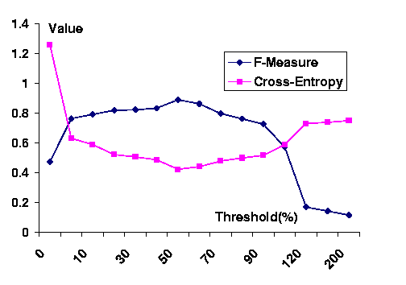
Relationship Between F-Measure and Cross Entropy
F-measure and Cross-entropy has invert relationship

Slide 19
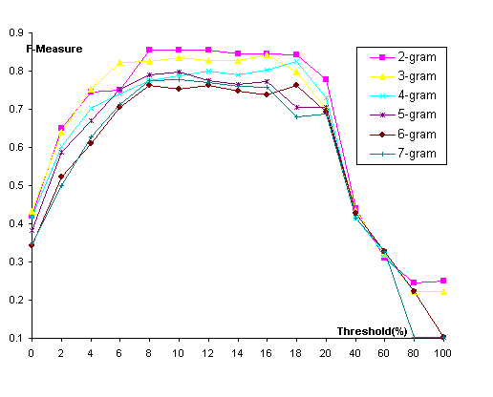
Parameter Selection –threshold value
Performance of n-gram method greatly depends on the threshold.
Automatic method for choosing a threshold is proposed:
  Estimate average session length from training data/development data
  Estimate num. of sessions in test data:length/(average session length)
  Obtain the value for each point and sort them in decreasing order.
  The value near the position length/(average session length) is chosen

Slide 20
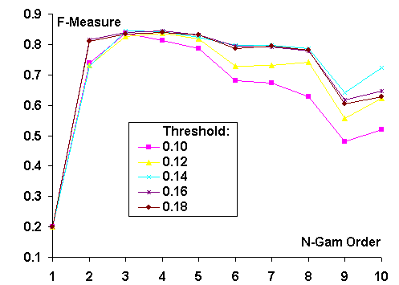
Parameter Selection – n-gram order
An order between 2 and 8 is generally good.
The performance with a lower order (from 2 to 5) is better than that with a higher order (from 6 to 8).
The best order value is the model with minimal cross-entropy on the test data (for supervised learning) or that with maximal F-measure on the development data (for un-supervised learning or semi-supervised learning)

Slide 21
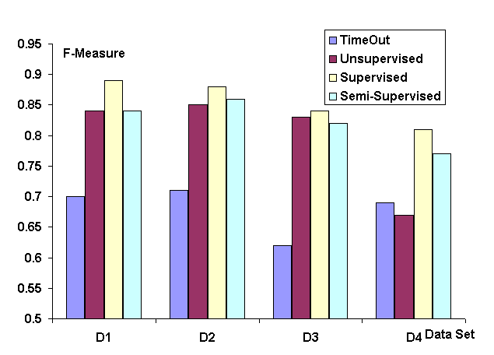
Performance Comparisons
Supervised > Semi-Supervised > Unsupervised > Timeout

Slide 22
Mining User Access Patterns (4)
- User Session Classification
The task of session clustering is to group session instances to different session groups. The number of groups is unknown, and it is a un-supervised learning procedure.
A distance-based session clustering algorithm is proposed:
  Consider each session instance as a session group, and calculate the distance between them.
  Groups are merged according to the intra-group distances, intra-group distances are updated correspondingly.
  The clustering procedure will stop when all intra-group distances are more than a pre-defined distance threshold.
Distance between two sessions i and j is defined as: distance(i,j)= 1.0 – sim (i,j), where sim(i, j) is the similarity between two sessions

Slide 23
Mining User Access Patterns (4)
- User Session Classification Cont.
Three similarity scores are proposed:
  Coefficient score: treat i and j as un-ordered item set, the score is the fraction of common events between them:
  csim(i,j) = | i ∩ j |/|i ∪ j |
  Alignment score (asim): treat i and j as request sequences, aligns them first, calculates the score based on the aligned sequences.
  Neighborhood score (nsim): is the common neighbors between i and j. “Two sequences are neighbor if their distance based on the above two scores exceeds certain threshold”
The overall similarity between i and j is
sim (i,j) = a * csim(i,j) + b* asim(i,j) + c * nsim(i,j), where a +b +c =1.0

Slide 24
Mining User Access Patterns (4)
- User Session Classification Cont.
In sequence alignment, two or more strings are aligned together in order to get the highest similarity score. Gaps may be inserted into a string in order to shift the remaining characters into better matches.
Two sequence {ABCDD} and {ABED} are aligned as:
ABCDD/ABED-
Treat a session sequence as a piece of programming code. The code may contain branches (such as if/else) or loops (such as for-loop and while-loop).
We assign each match with a score of 2 (A, and B), each branch with a score of 1 (C/E), and each loop with a score of 1 (DD/D).
To normalize the score, we divide the value with the length of the aligned sessions. The length is defined as
    2 * (num. of matches + num. of branches + num. of loops)

Slide 25
Mining User Access Patterns (4)
- User Session Classification Cont.
Clustering Algorithms:
  Random sampling N sessions, clustering the sessions into different session groups.
  Assigning the session remaining in the disk to the groups obtained in step 1, creating new group if necessary.
Question:
  How to choose similarity parameters a, b and c? The parameters are the weight of the three similarity scores.
  How to choose clustering threshold? depending on the application domain
  How to deal with short session? with some expert knowledge.

Slide 26
Model User Access Patterns (1)
Task: building user access graph for each session group.
Markov model based user access graph generation
  Scan all session instances, generate states and state transitions
  Prune states and transitions based on min. support and confidence
  Build state transition diagram
First-order and second-order pruned-Markov models for session instances <a,b,c>, <a,b,c,b>, <a,b,d>, <a,b,d,b> are
First Order Markov Model
Second Order Markov Model
S1: (start),
S2: (a),
S3: (b),
S1: (start), S2: (start, a), S3: (a,b), S4: (b,c)
S4: (c),
S5: (d),
S5: (b,d),
S6: (c,b), S7:(d,b),
Freq
S1
S2
S3
S4
S5
S6
S7
Freq
S1
S2
S3
S4
S5
S1
4
0
4
0
0
0
0
0
S1
4
0
4
0
0
0
S2
4
0
0
4
0
0
0
0
S2
4
0
0
4
0
0
S3
4
0
0
0
2
2
0
0
S3
6
0
0
0
2
2
S4
2
0
0
0
0
0
1
0
S4
2
0
0
1
0
0
S5
2
0
0
0
0
0
0
1
S5
2
0
0
1
0
0
S6
1
0
0
0
0
0
0
0
S4
S7
1
0
0
0
0
0
0
0
0
c
d
5
.
start a b
0
c
0.33
start a b
5
0
S4
0.5
S6
S1
S2
S3
.
1.0
1.0
0
0
S1
S2
S3
.
d
1.0
1.0
3
c
0.33
3
d
S5
0
.
5
0
S5
0.5
S7

Slide 27
Model User Access Patterns (2)
Task: find the relationship between nodes of graph
Solution: using idea of functional dependency inference
  All node parameters make a virtual database relation R
  All session instances make a instance r of R
  Find function dependencies from relation instance r
  Discovery dependency functions or decision rules
  Prove dependencies and functions with the help of expert
Extension:
  How to deal with parameters within the same node?
  How to deal with branch, i.e., some parameters will not appear in a session: assign a “unknown” value to the columns
  How to deal with loop, i.e.,some parameters have multiple values in a session: 1) consider columns that agree on all values in all sessions. 2) consider sequence matching.
  How to deal with query result, i.e., the value of a parameter may be the execution of a query? Hard! Must have the original data of the database.

Slide 28
Dependency Discovery Example
1.consider inter-event and intra-event relationship separately
events | v30 | v31 | v32 | v32 | v33 | v34
 | col30_1 | col31_1 | col32_1 | col32_2 | col33_1 | col34_1
 | ‘c101’ | ‘c101’ | ‘c101’ | ‘1’ | ‘t202’ | ‘t202’
 | ‘c201’ | ‘c201’ | ‘c201’ | ‘1’ | ‘t123’ | ‘t123’
 | ‘c202’ | ‘c202’ | unknown | unknown | unknown | unknown
 | … | … | … | …. | …. | ….
 | ‘c212’ | ‘c212’ | ‘c212’ | ‘1’ | <‘t301’, ‘t302’> | <‘t301’, ‘t302’>
col
row
2. ignore unknown values
3. sequence matching
col32_2 is a constant, col33_1 is an independent variable, col31_1, col32_2 are dependent variables.
What is the relationship between the result of v32 with col33_1?
What about variable col30_1? Use high-level graph relationship.

Slide 29
Performance Evalution
How to measure the accuracy of session clustering and session modeling algorithm?
Idea:
  Model-based session classification. Given a session instance s, try to classify it into a session group g by using model-based Bayesian classification algorithm. If s and g has minimal distance, it is a “hit”.
  Model-based request prediction. Given a request sequence (r₁,….r_{n}), try to predict the next request r by using model-based prediction algorithm. If we predict the next request correctly, it is a “hit”.
  Use F-measure to measure the performance

Slide 30
Experimental Results
Mining result for a client/server application:
12 instances of the application, and 9,344 SQL queries.
190 user access events.
718 user request sequences belong to 21 frequent user access graphs
An instance of user access graph P1
High-level user access graph
q1. select authority
from employee
where employee_id ='1025‘
q2. select count(*) as num
from customer
where cust_num = '1074'
q3. select card_name
from customer t1,member_card t2
where t1.cust_num = '1074‘ and t1.card_id =t2.card_id
q4. select contact_last,contact_first
from customer
where cust_num = '1074'
q5. …
P15
0
.
0
8
P3
same table
0
.
0
3
P2
0.07
P9
Graph P1_1
0
.
5
3
0
.
1
7
support =175
P1
0
.
2
1
P14
P11
P4
0.13
P3
Graph P1_2
support =16
P16
0.65
P13
0.77
0.80
Graph P1_3
P21
P20
support =20
Broken q3 into two queries, q2’ and q2’’. q2’,q3,q4 can be rewrite as:
select count(*) as num, card_id,
contract_last, contract_first
from customer
where cust_num=‘1074’
same predicate

Slide 31
Usage of User Access Patterns
User access patterns can help to
optimize SQL query to gain fast execution time. Find the system bottleneck, i.e., resource-consumed queries and frequently-performed queries. Redesign/optimize them
tune the database system. Distinguish the step of finding user behaviors with the step of using them. Tuning database system based on user access patterns is better than analyzing the queries in a workload.
anticipate and pre-fetch incoming queries. Try to match user request sequence with a user access graph, and predict the next query.
rewrite queries for caching. Find the relationship between queries, and rewrite a query to answer subsequent queries.
process queries by using rules. Design a rule-based database gateway, use rules to rewrite, pre-fetch queries.
find possible data distributions or relationships

Slide 32
SQL-Relay: an Event-driven, Rule-based Database Gateway
Each incoming query is one kind of event. Each event associates with a set of pre-defined execution rules.
SQL-Relay contains a set of standard routine to process a given execution rule.
Previous query results are cached for answering incoming queries. Two kinds of query cache: global caches and local caches. Different cache selection and replacement policies are used for different kinds of cache.
A global rewriting rule aims to rewrite a single query to improve query performance;
A pre-fetching rule predicts the next query and pre-fetches the answer according to user request sequence.
A local rewriting rule rewrites current query to answer multiple queries.

Slide 33
Related Works
Workload Characterization
  Clustering database transaction (based on physical resources)
  Discovering and using physical resource reference pattern (disk I/O, buffer pool)
  Predicting and prefetch OLAP queries.
Query stream processing
The idea and algorithms discussed can be used on web-based session identification and clustering.
Database cache server and gateway
  DBCache (IBM), TimesTen (TimesTen), Oracle 9i database cache. All caches database tables.
  MySQL has server-side query caches.
  Information Integrator (IBM) allows users to retrieve information from different data sources by using standard query language. It rewrite queries according to certain rule.

Slide 34
References
Q. Yao, A. An “Using user access patterns for semantic query caching” in DEXA 2003
Q. Yao, A. An “Characterizing database user’s access patterns” in DEXA 2004
Q. Yao, A. An “SQL-Relay: an event-driven, rule-based database gateway” in DEXA 2004
Q. Yao, X. Huang, A. An “Applying language modeling to session identification from database trace Logs”, submitted for publication
Q. Yao, X. Huang, A. An “ Finding and clustering database user sessions”, submitted for publication.
I.T. Bowman, K.Salem, ”Optimization of query streams using semantic prefetching”, in SIGMOD 2004.
X. Huang and F. Peng and A. An and D. Schuurmans,” Dynamic Web Log Session Identification with Statistical Language Models”, Journal of JASIST, Special Issue on Webometrics, 2003.

Slide 35
Conclusion and Future Work
We propose the idea of user access pattern to represent database user navigation behaviors
We propose algorithms to cluster SQL queries, identify users and sessions, cluster and model sessions.
Several approaches of using user access patterns are discussed.
Future Work:
  Researching on large scale database
  Extending to web log and applications

